Slide 1
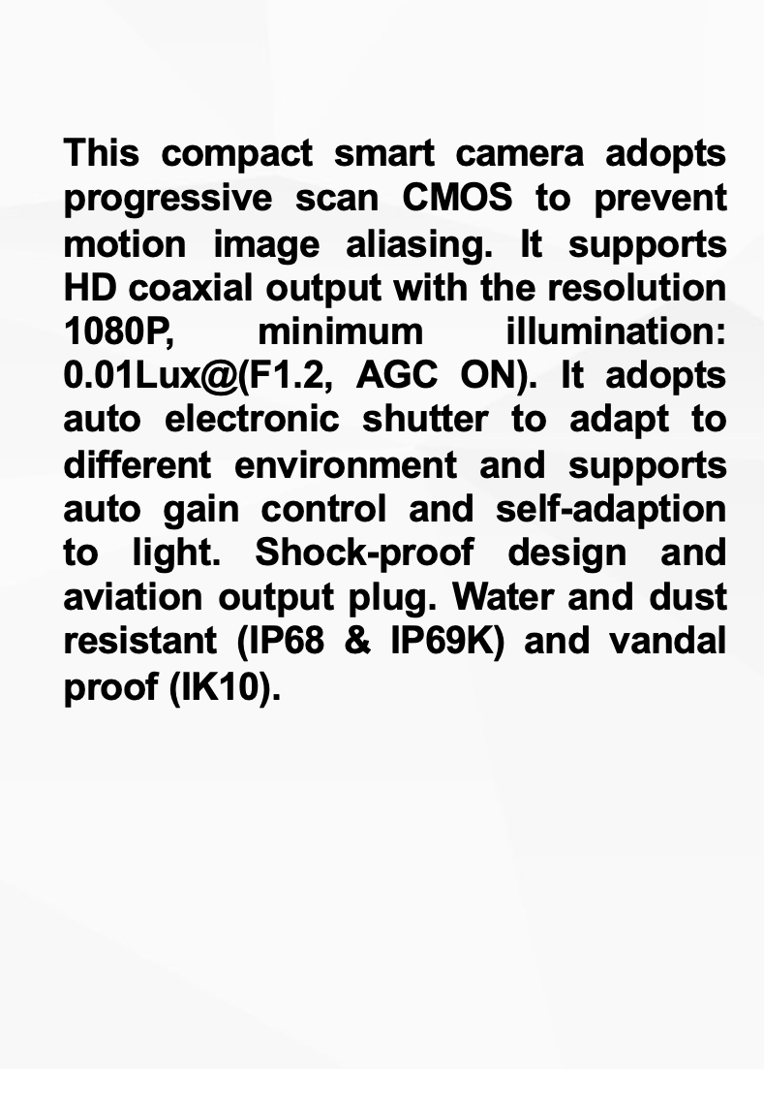
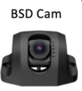



Automated Blind Spot Monitoring System

Slide 2
Automated Blind Spot Monitoring System
Capable of detecting humans, vehicles, and bicycles.
Effectively filters out unnecessary alerts.
Can be installed for front and sides as well.
Detection distance up to 7 meters.
Comes with audible and visual alerts (LCD screen and buzzer)

Slide 3
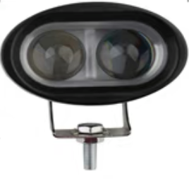
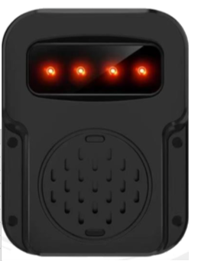
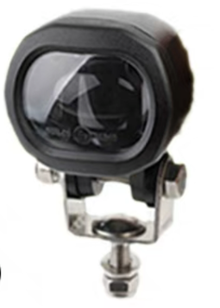
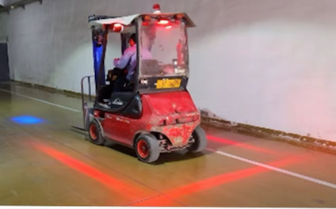
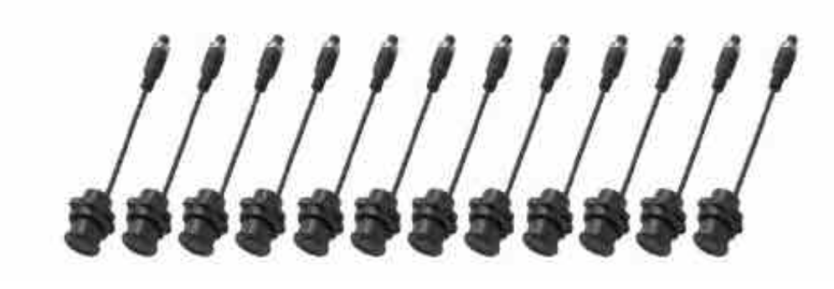
Red Zone Warning System with proximity sensors
Red Zone
Proximity lights
External Warning Speaker
Headway Warning Light
Give pedestrian warning about incoming forklift
Proximity sensor in 2 tiers
(1m & 1.5m)

Slide 4
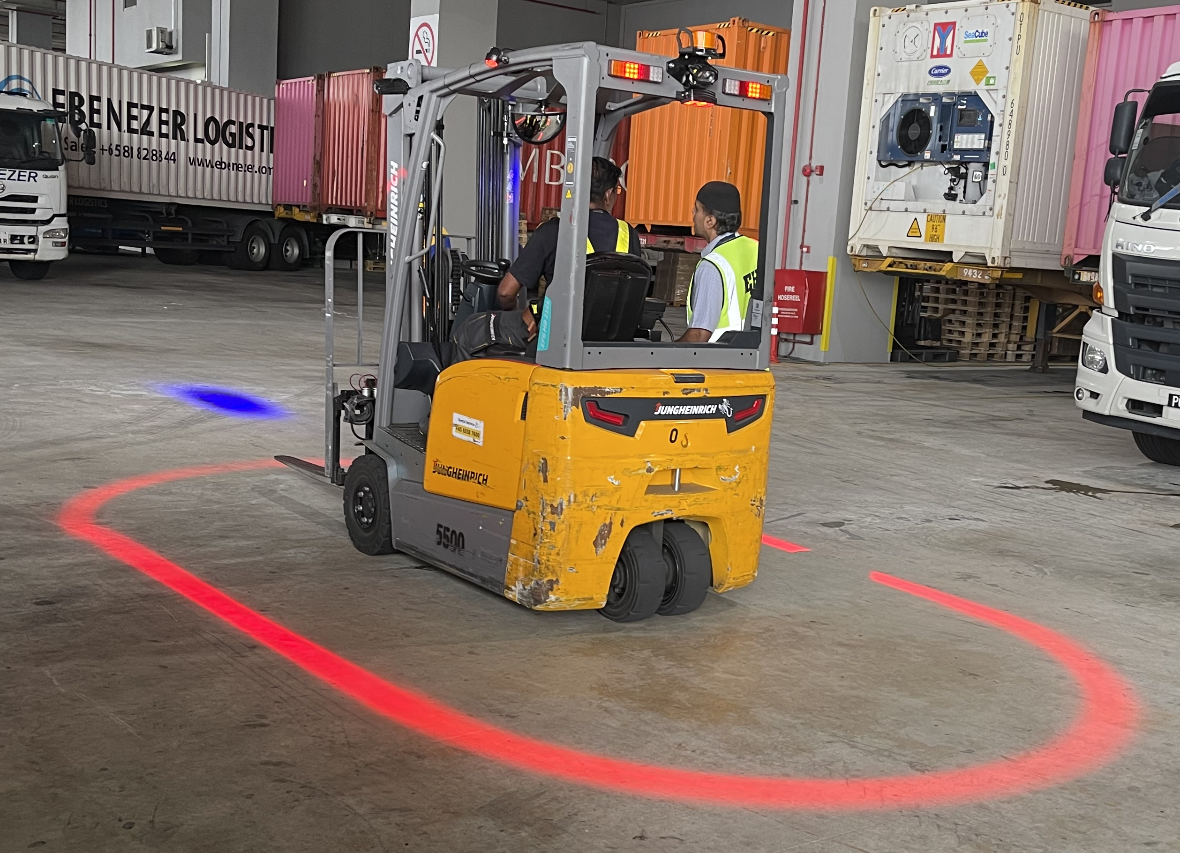
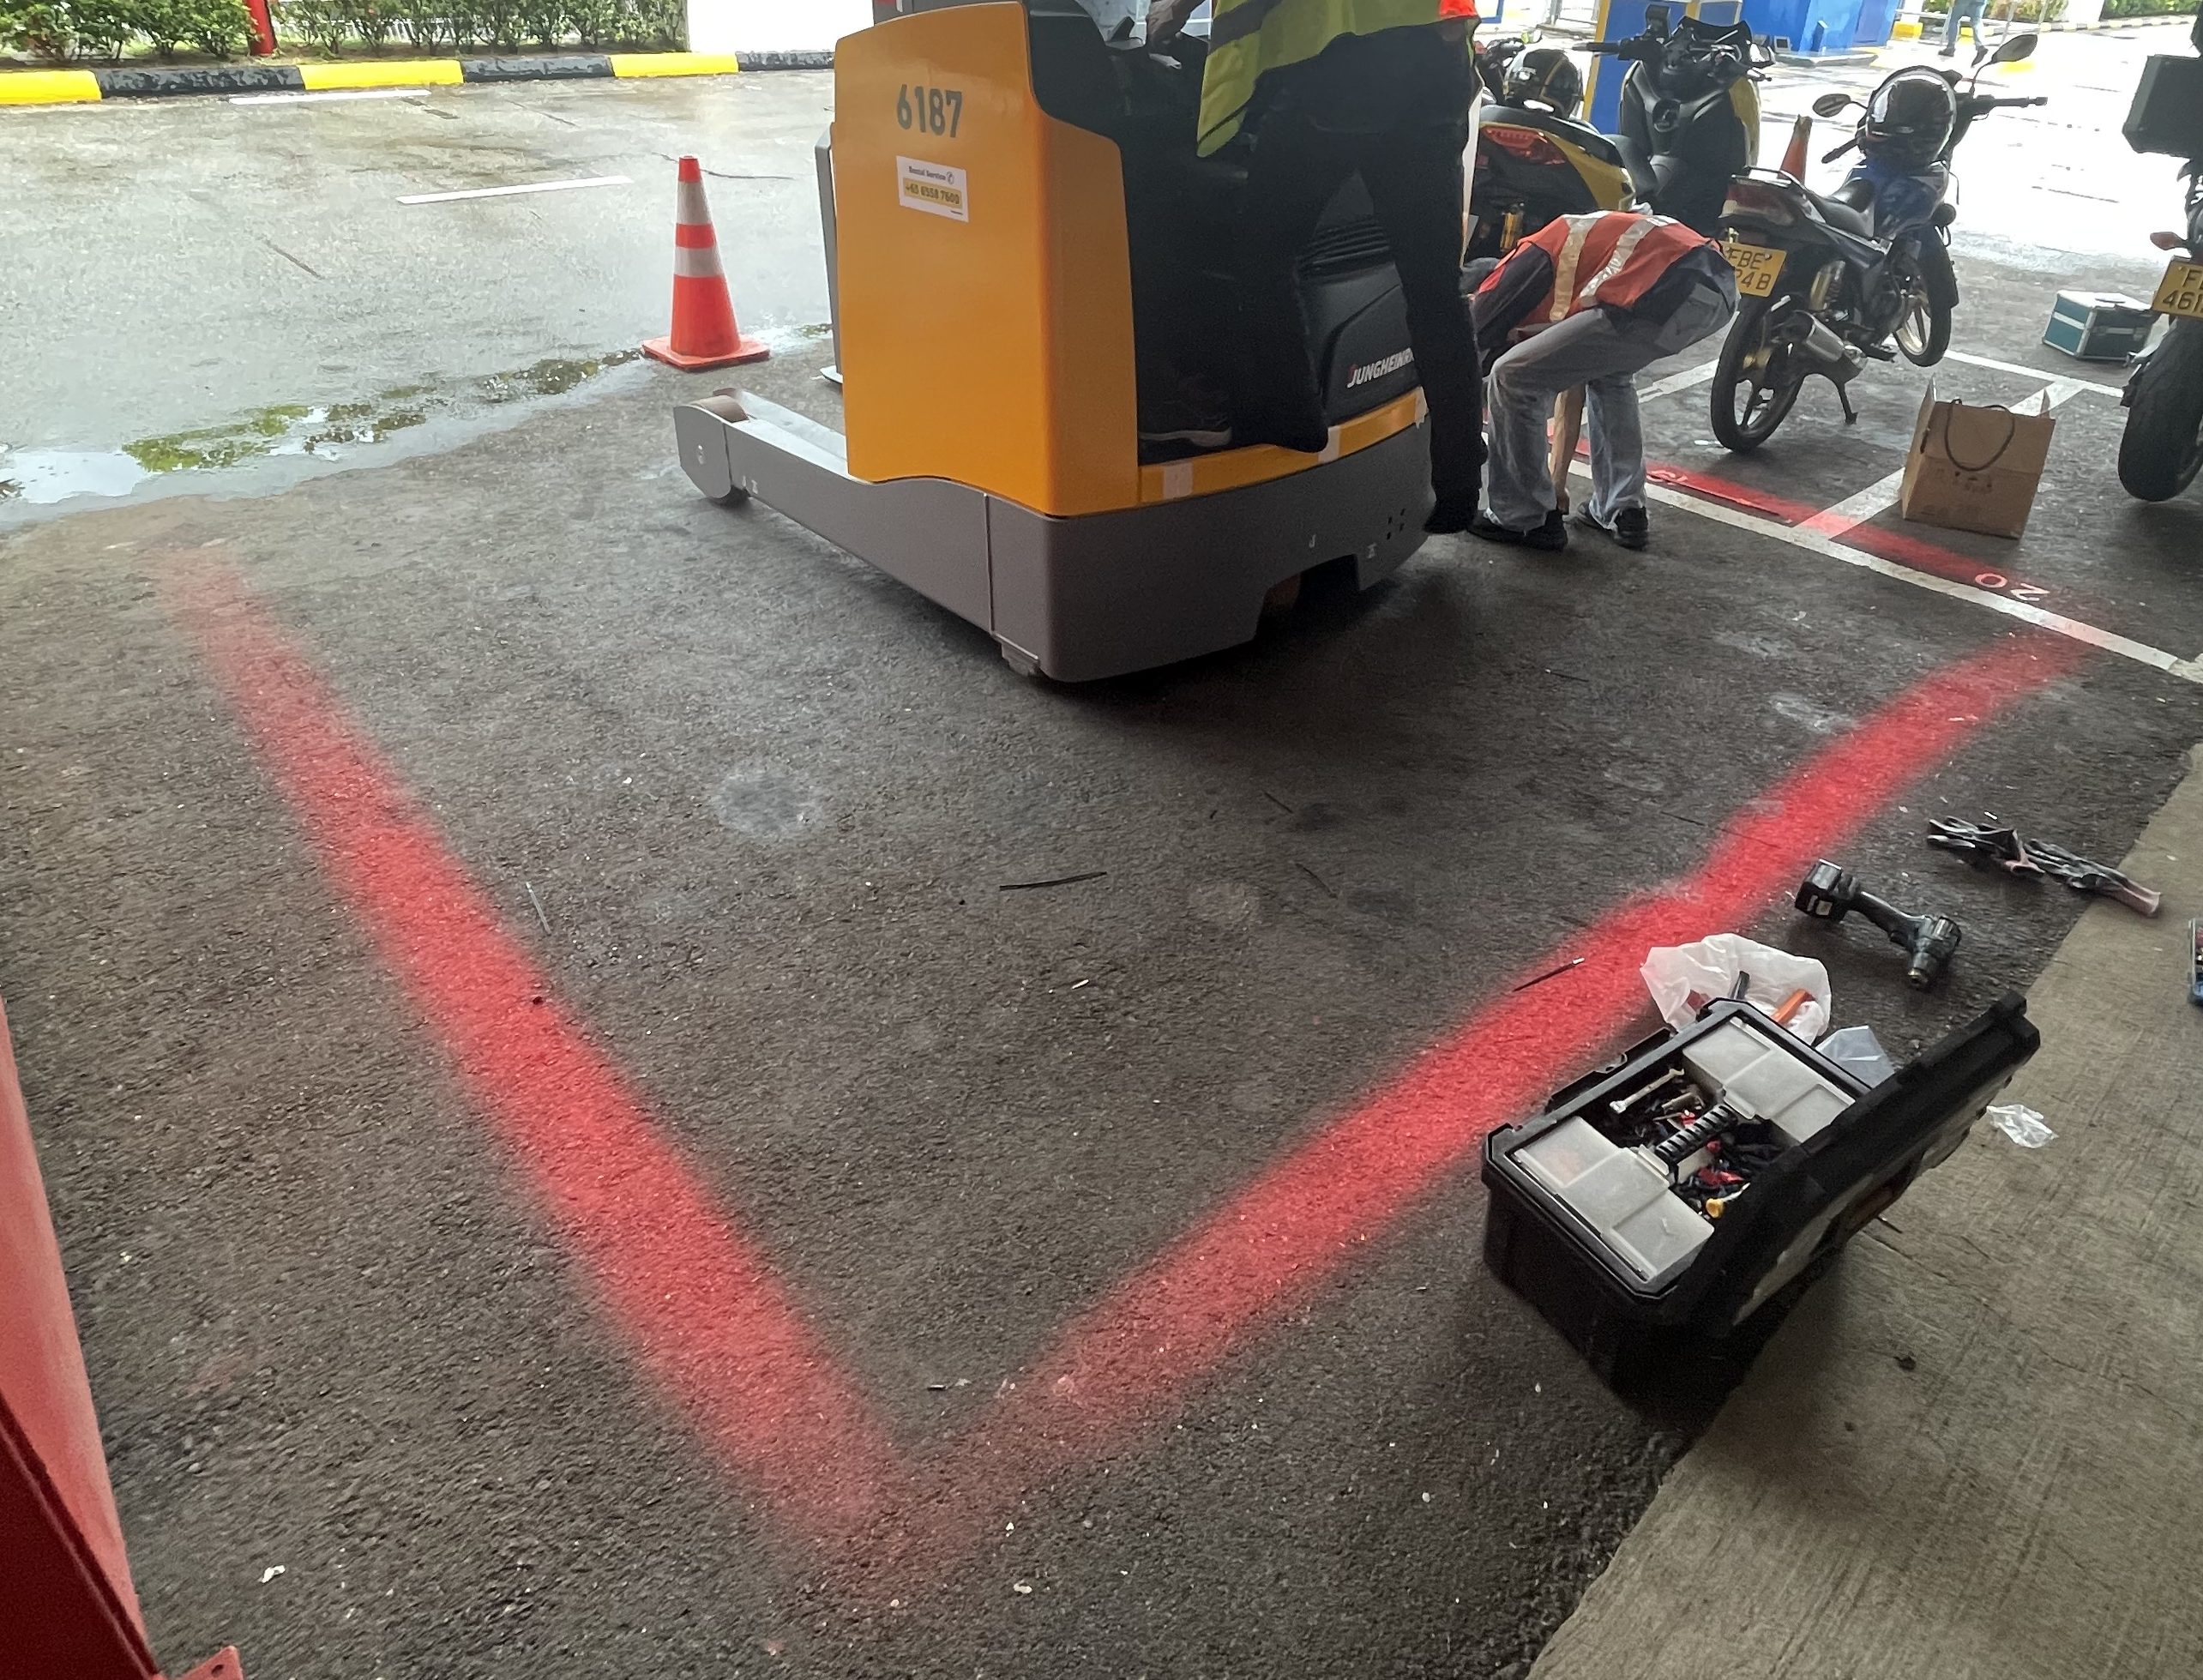
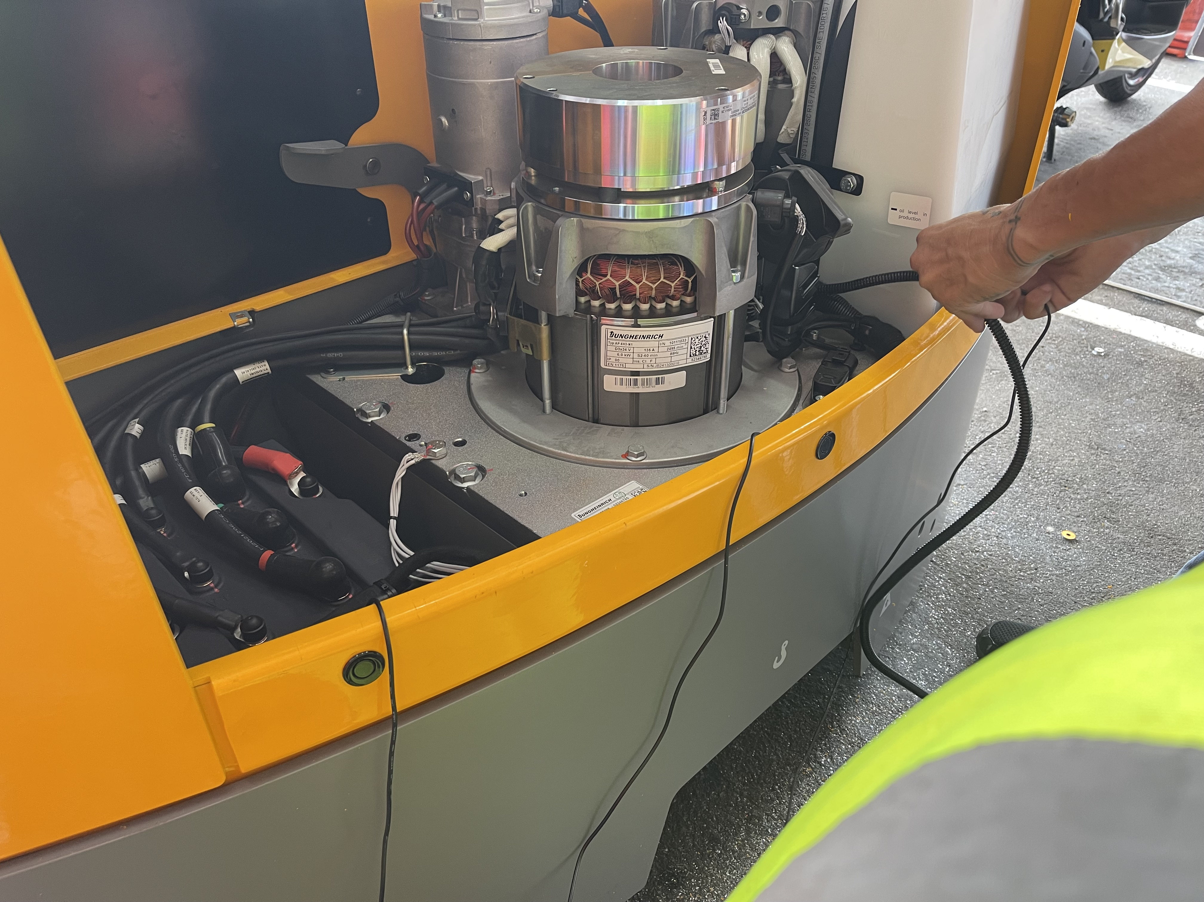
Red Zone Warning System with proximity sensors
Red Zone
Proximity lights
Proximity sensor in 2 tiers
(1m & 1.5m)

